Slide 1



Pareto Comparison Plots

Slide 2
ZDT1

Slide 3
ZDT2

Slide 4
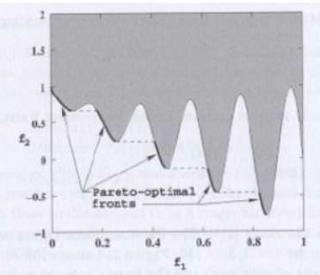
ZDT3
GOAL
Achieved

Slide 5
ZDT2
GOAL
Achieved

Slide 6
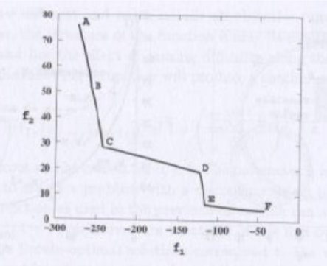
OSY
GOAL
Achieved

Slide 7
CTP
GOAL
Achieved

Slide 8
TNK
GOAL
Achieved

